Slide 1
Case Quest 2.0
- BHARANI KADAMBAN S(MBT8)

Slide 2
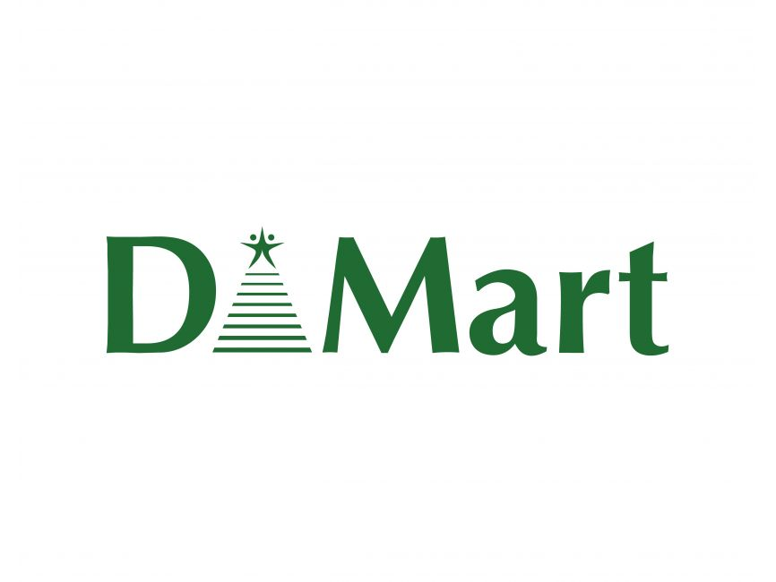
In this case study , we could explore the below company:

Slide 3
DMART
Founded: 2002, by Radhakishan Damani, one of India’s leading business tycoons.
Business Model: Operates on a high-volume, low-margin strategy, ensuring unbeatable pricing for essential goods.
Store Network: Over 300+ stores across India, showcasing an expansive retail footprint in 13+ states.
Core Offerings: Specializes in value retailing, offering a comprehensive range of household essentials, groceries, personal care, and apparel at competitive prices.
Customer-Centric Approach: Focuses on delivering a seamless shopping experience, with well-organized, clutter-free stores designed for convenience.
Financial Growth: Consistently maintains a robust financial performance, becoming a benchmark in retail profitability across the Indian market.

Slide 4
BUSINESS MODEL
High Volume, Low Margin Strategy: DMart focuses on selling large volumes of products at minimal profit margins, enabling it to offer products at highly competitive prices.
Cost Efficiency: An operational model ensures cost minimization at every level. By negotiating directly with manufacturers and suppliers, DMart achieves favorable pricing, which is passed on to customers.
Own Store Ownership: DMart prefers owning its stores rather than leasing them, which reduces long-term rental costs and allows greater control over operational expenses.
Self-service Format: The stores follow a self-service model, reducing the need for a large sales staff, further cutting down operational costs.
Customer-centric Pricing: DMart constantly monitors market prices and adjusts its own pricing to ensure it remains the lowest in the market, maintaining strong customer loyalty.

Slide 5
Porter’s 5 Forces
Competitive Rivalry:
Intensity of Competition: DMart operates in a highly competitive retail environment, where numerous players, such as Reliance Retail, Big Bazaar, and online platforms like Amazon and Flipkart, compete for market share.
Pricing Pressure: Given low-price strategy, it faces constant pricing pressure from competitors offering discounts, leading to a price-sensitive market where maintaining customer loyalty becomes key.
Differentiation and Scale: Despite the fierce competition, DMart’s large-scale operations, cost-efficient supply chain, and widespread store network help it maintain a strong foothold.
Threat of New Entrants:
Brand Loyalty: DMart’s reputation for affordability and trust further acts as a barrier, as new entrants would need significant investment and pricing strategy to match its loyal customer base.
Government Regulations: In the Indian retail sector, complex regulatory policies related to FDI (Foreign Direct Investment) in retail and compliance costs also limit the entry of international players.

Slide 6
Porter’s 5 Forces
Bargaining Power of Supplier:
Supplier Relationships: DMart’s strong long-term relationships with manufacturers and suppliers allow it to negotiate bulk purchases at favorable prices, helping to maintain its low-margin model.
Limited Supplier Power: Since DMart is a major buyer with extensive volumes, the bargaining power of individual suppliers is relatively limited. Suppliers are motivated to provide the best terms to remain in DMart’s supply chain.
Exclusive Deals: DMart also negotiates exclusive product deals and private-label offerings, reducing supplier influence while enhancing its competitive pricing.
Bargaining Power of Buyers:
Price-Sensitive Customers: DMart caters primarily to the middle and lower-income groups in India, who are extremely price-sensitive. Thus, the ability of customers to switch to alternative retailers is high if they find better prices.
Customer Loyalty: DMart mitigates this through its consistent low prices and convenience, which builds brand loyalty and reduces the likelihood of customers shifting to competitors.
Limited Negotiation Power: Individual buyers have low bargaining power because DMart offers standardized pricing for all, without room for individual negotiation.

Slide 7
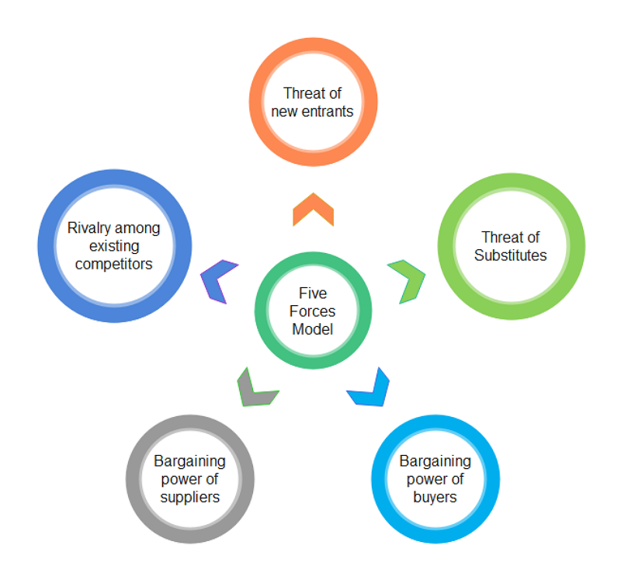
Porter’s 5 Forces
Threat of Substitutes:
E-commerce Platforms: The rise of online shopping platforms such as Amazon, Flipkart, and grocery delivery apps like BigBasket presents a significant threat, offering customers the convenience of home delivery and competitive pricing.
Experience-Based Differentiation: However, DMart’s strategy of offering a superior in-store experience, with a focus on cost-effective shopping and a wide range of everyday products, helps in reducing the attractiveness of substitutes.
Omnichannel Strategy: DMart’s gradual adoption of an online presence (DMart Ready) is designed to counteract the threat of online substitutes, ensuring that it caters to both physical and digital customers.

Slide 8
STP Analysis
Segmentation:
Demographic Segmentation:
Income Levels: Targets middle-class & lower-middle-class consumers who seek affordable products.
Family Size: Focuses on families and households that require bulk purchasing for groceries and daily essentials.
Geographic Segmentation:
Urban and Semi-Urban Areas: Concentrates on densely populated urban regions, expanding gradually into tier-2 and tier-3 cities.
Regional Preferences: Offers localized products to cater to diverse regional tastes and preferences.
Behavioral Segmentation:
Buying Behavior: Targets price-sensitive customers who are value-conscious and prefer bulk purchases to save money.
Shopping Habits: Focuses on customers who prefer one-stop shopping for daily essentials, groceries, and household items.

Slide 9
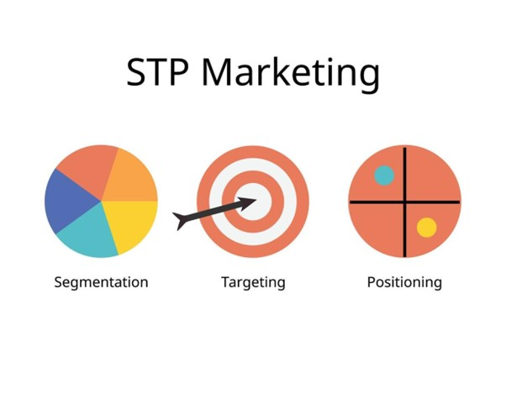
STP Analysis
Targeting:
Primary Target: Middle-class families looking for quality products at competitive prices. DMart appeals to consumers who prioritize value and affordability over brand loyalty.
Secondary Target: Young professionals and college students who seek convenience and cost savings when shopping for daily essentials.
Positioning:
Value Proposition: Positioned as a cost-effective retail chain, offering a wide range of products at lower prices than competitors, thanks to its efficient supply chain and bulk purchasing strategy.
Brand Image: Markets itself as a trusted retailer that prioritizes customer satisfaction and reliability, fostering loyalty among price-sensitive consumers.

Slide 10
Statistical Data
Revenue Growth:
2023 Revenue: ₹43,936 Crores (approx.) and Annual Revenue - 20-25% over the past 5 years
Profit Margins:
Gross Profit Margin: Approx. 14.7%.
Net Profit Margin: Around 8.3%, demonstrating strong cost controls and efficient operations.
Store Network:
Number of Stores: 330+ stores across 13 states.
Store Size: Average store size of 35,000 sq. ft, catering to a broad customer base across urban and semi-urban locations.
Employee Strength:
Total Workforce: 9,000+ full-time employees and 18,000+ contractual workers, ensuring smooth store and supply chain operations.
Market Capitalization:
Current Market Cap: Over ₹2.4 lakh crores (approx.), making DMart one of the largest and most valued retail chains in India.
Stock Performance: DMart’s stock price has shown a 5-year CAGR of 30%, making it one of the most successful stocks in the Indian market.

Slide 11
Customer Review
High Impact: Customers frequently commend DMart's exceptional value and competitive pricing, which significantly influences new shoppers to choose DMart over other retailers, ultimately driving sales growth and market share.
Medium Impact: Positive feedback regarding the wide product range and organized store layout enhances customer satisfaction and loyalty, fostering a repeat shopper base and encouraging word-of-mouth recommendations.
Low Impact: While some customers mention their desire for a more comprehensive online shopping experience, this feedback currently has limited influence on DMart’s overall performance, as the majority of shoppers prefer the in-store experience.

Slide 12
Conclusion:
Porter’s 5 Forces Analysis for DMart reveals a landscape characterized by intense rivalry among established retailers and e-commerce platforms, exerting pressure on pricing strategies. The threat of new entrants remains moderate due to capital requirements and brand loyalty. Supplier bargaining power is limited, as it leverages bulk purchasing to secure favorable terms. Buyer bargaining power is high, driven by price sensitivity, necessitating consistent value delivery. Additionally, the growing threat of substitutes underscores the urgent need for digital integration.
STP Analysis for DMart reveals a well-defined approach to identifying customer segments, targeting them effectively, and positioning itself as a leader in the Indian retail market. By focusing on affordability, value, and customer experience, DMart continues to strengthen its brand and expand its market presence.

